Slide 1

Automotive Technology: A Systems Approach, 8e
Chapter 16: General Electrical System Diagnostics and Service
Rob Thompson and Jack Erjavec, Automotive Technology: A Systems Approach, 8th Edition. © 2025 Cengage. All Rights Reserved. May not be scanned, copied or duplicated, or posted to a publicly accessible website, in whole or in part.

Slide 2
Chapter Objectives (1 of 2)
16.01 Describe the different possible types of electrical problems.
16.02 Read electrical diagrams.
16.03 Perform troubleshooting procedures using testing tools such as meters, test lights, and jumper wires.
16.04 Explain how to use a DMM for diagnosing electrical and electronic systems.

Slide 3
Chapter Objectives (2 of 2)
16.05 Explain how to use a lab scope for diagnosing electrical and electronic systems.
16.06 Test common electrical components.
16.07 Diagnose common electrical circuit problems.
16.08 Perform wire and connector repairs.

Slide 4
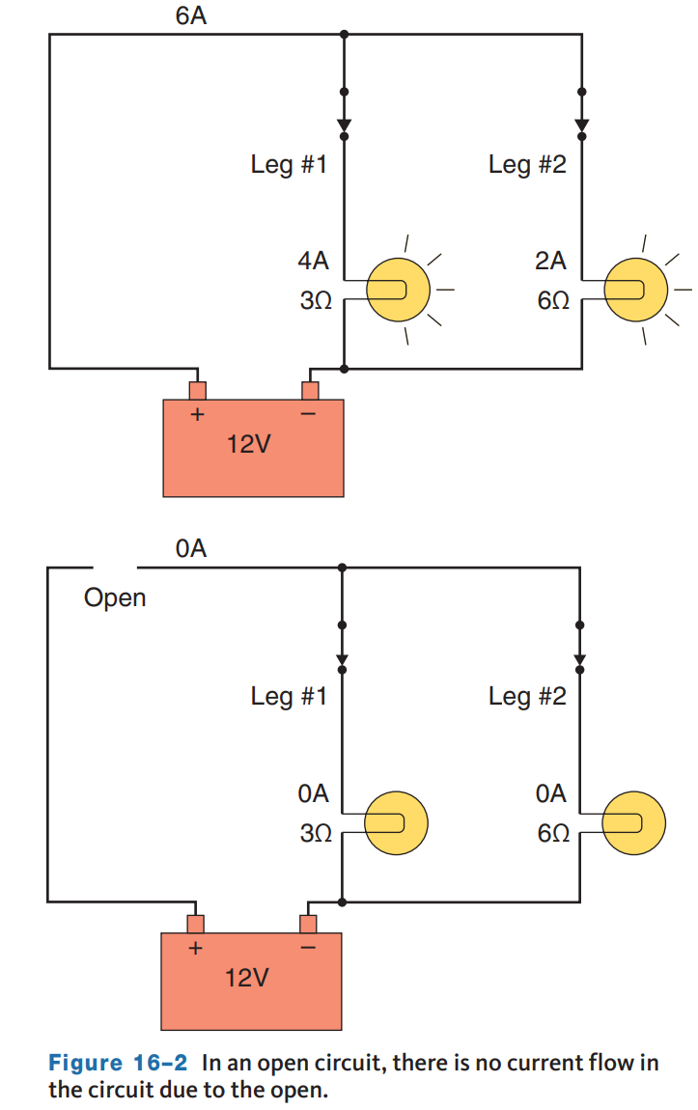
Electrical Problems (1 of 3)
16.01 Describe the different possible types of electrical problems.
An open circuit occurs when a circuit is incomplete.
Without a completed path, current cannot flow, voltage is not dropped, and the load or component will not work.
An open circuit can be caused by a disconnected wire or connector, a broken wire, or a switch in the off position.
When a circuit is off, it is open. When the circuit is on, it is closed.
Switches open and close circuits, but at times a fault, such as worn or burned contacts, in the switch will cause an open.

Slide 5
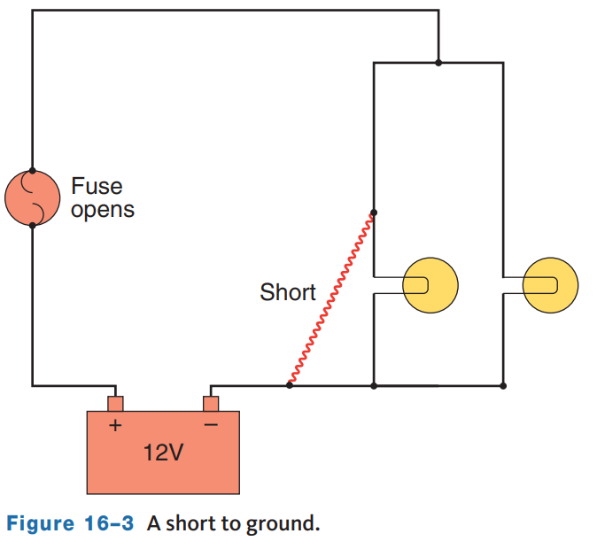
Electrical Problems (2 of 3)
When a circuit has an unwanted path for current to follow, it has a short.
Shorts can be either to power or to ground.
A short circuit is sometimes referred to as a low-resistance circuit.
When an energized wire accidentally contacts the frame or body of the car or another wire, circuit current can travel in unintended directions through the wires.
Shorts are caused by damaged wire insulation, loose wires or connections, damaged connections, improper wiring, or careless installation of accessories.
A short creates an unwanted parallel leg or path in a circuit.

Slide 6
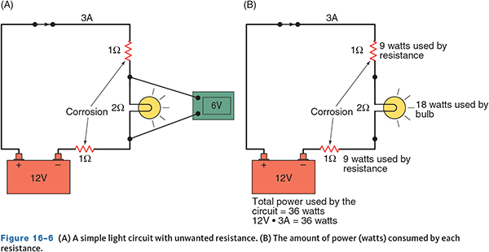
Electrical Problems (3 of 3)
Resistance problems occur when there is unwanted resistance in the circuit.
The higher than normal resistance causes the current flow to be lower, and the components in the circuit cannot operate properly.
A common cause of this problem is corrosion at a connector.
The corrosion becomes an additional load in the circuit.
This load uses some of the circuit’s voltage, which prevents full voltage to the circuit’s normal loads.

Slide 7
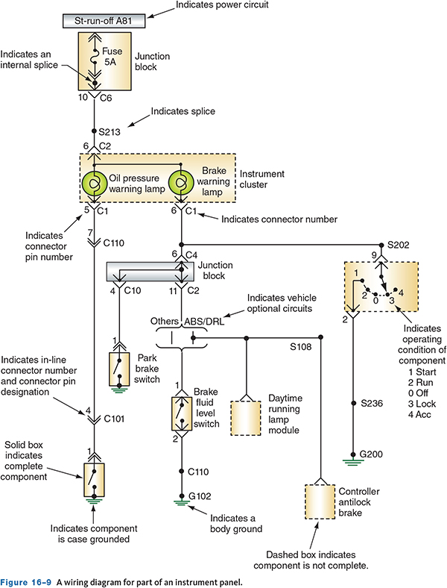
Electrical Wiring Diagrams
16.02 Read electrical diagrams.
Wiring diagrams, sometimes called schematics, show how circuits are constructed.
These diagrams are used to diagnose and repair a vehicle’s electrical system.
They identify the wires and connectors in every circuit of a vehicle.
A wiring diagram does not show the actual location of the parts or their appearance, nor does it indicate the length of the wire that runs between components.
It does show the color of the wire’s insulation and sometimes the wire gauge size.
The diagram may also include the circuit number, connector and terminal identification, and general location of components.

Slide 8
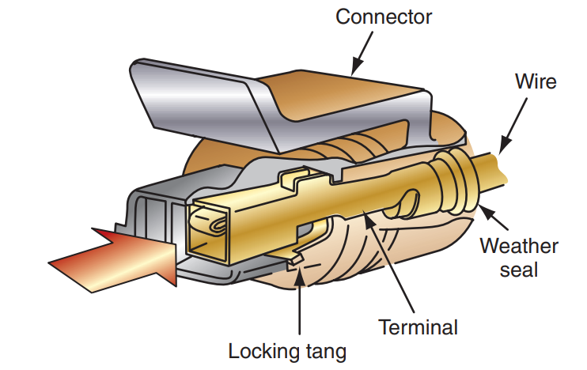
Connector and Terminals
An electrical terminal is a copper, brass, or steel end crimped or soldered to a wire.
When mated to another terminal, an electrical connection is made.
A connector slips into or over another connector, depending on the connection; a connector is either a male or female.
There are different types of connectors

Slide 9
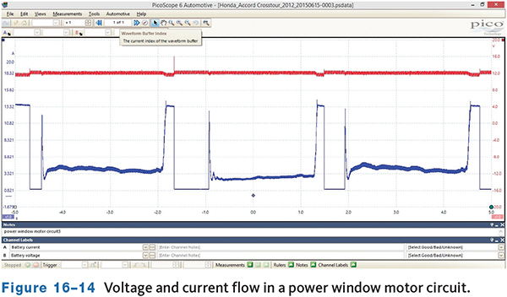
Electrical Testing Tools (1 of 3)
Lab Scopes
  Lab scopes are fast-reacting meters that measure and display voltages within a specific period of time.
  The voltage readings appear as a waveform or trace on the scope’s screen.
  The waveform displays what is happening and any problems can be observed when they happen.

Slide 10
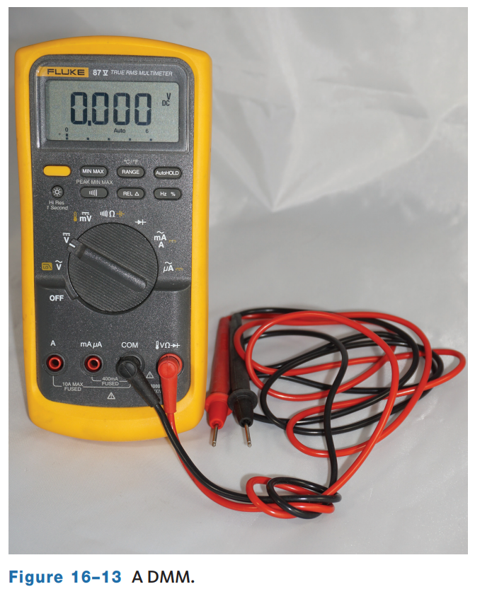
Electrical Testing Tools (2 of 3)
A multimeter is one of the most important tools for troubleshooting electrical and electronic systems.
A basic multimeter measures DC and AC voltage, current, and resistance.
Because most of today’s multimeters have a digital display, they are commonly referred to as a digital multimeter or DMM.
Most DMMs also check engine speed, signal frequency, duty cycle, pulse width, diodes, and temperature.
The desired test is selected by turning a control knob or depressing keys on the meter.
These meters can be used to test simple electrical circuits, ignition systems, input sensors, fuel injectors, batteries, and starting and charging systems.

Slide 11
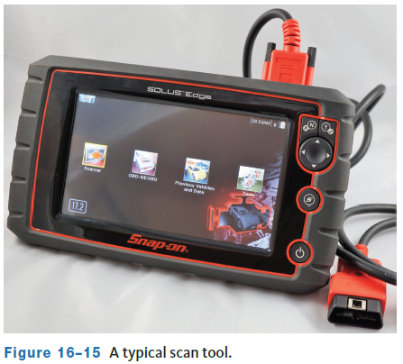
Electrical Testing Tools (3 of 3)
A scan tool may be used as part of diagnosing an electrical issue because many of the systems on modern vehicles are computer controlled or monitored.
A scan tool can retrieve fault codes from a computer’s memory and digitally display these codes.
A scan tool may also perform other diagnostic functions depending on the year and make of the vehicle and the capabilities of the tool.
This may include system calibrations and bidirectional controls.
Trouble codes are typically set when a voltage signal is entirely out of its normal range.
The codes help technicians identify the cause of the problem.

Slide 12
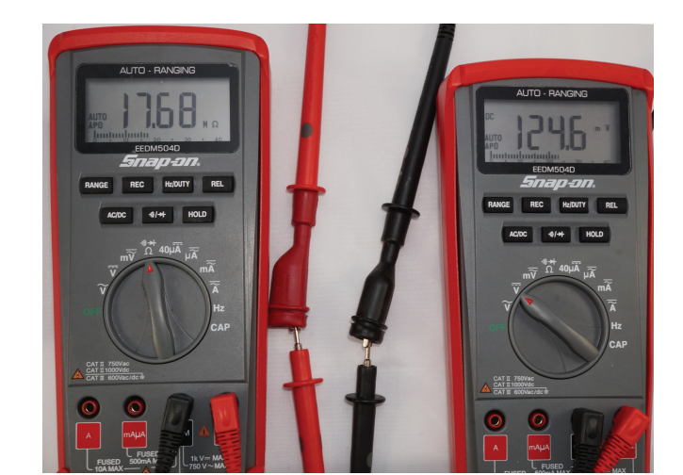
Using Multimeters (1 of 3)
Multimeters are available with either analog or digital displays.
Analog meters use a needle to point to a value on a scale and are seldom used on today’s vehicles.
A digital meter shows the value in numbers or digits. The most commonly used meter is DMM, sometimes called a digital volt/ohm meter (DVOM).
DMMs have high input impedance, 1 megohm (million ohms) to 10 megohms or more, and the metered voltage for resistance tests is below 5 volts, reducing the risk of damage to delicate electronic components and circuits.
The front of a DMM normally comprises sections: the display area, range selectors, mode selector, and jacks.

Slide 13
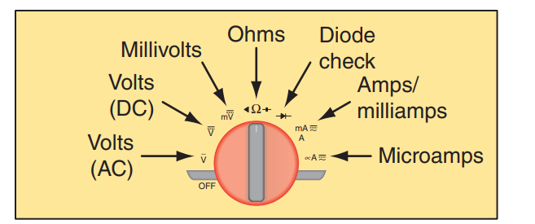
Using Multimeters (2 of 3)
When using a meter with auto range, make sure you note the range being used by the meter.
There is a big difference between 10 ohms and 10,000,000 (10 M) ohms.
The mode selector defines what the meter will be measuring.
Most DMMs have two test leads and four input jacks.
The black test lead always plugs into the COM input jack and the red lead plugs into one of the other input jacks, depending on what is being measured.
Typically, the three input jacks are:
  “A” for measuring up to 10 amps of current
  “A/mA” for measuring up to 400 mA of current
  “V/Ω/diode” for measuring voltage, resistance, conductance, capacitance, and checking diodes

Slide 14
Using Multimeters (3 of 3)
16.04 Explain how to use a DMM for diagnosing electrical and electronic systems.
Before using the meter, you should perform a couple of basic checks:
Begin by inspecting the meter leads and probe tips and make sure they are in good condition with no damage.
Next, set the meter to measure ohms and continuity.
  Hold the two probe tips together; the meter should beep and show a low resistance reading. This indicates the leads are not open.
  Wiggle the leads while performing this test. If the beep from the continuity test starts and stops while wiggling the leads, one or both are likely failing.
Before performing voltage tests, ensure the meter reads voltage correctly at a known source.
  For example, before testing voltage in a circuit on a vehicle, make sure the meter reads battery voltage correctly at the battery. This serves two purposes; you verify that the meter is working properly, and it gives you a battery voltage reading for the vehicle you are working on.

Slide 15
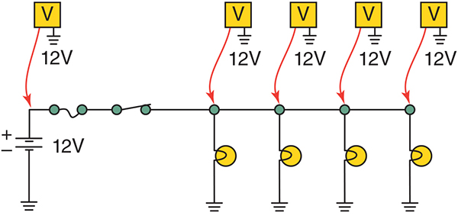
Measuring Voltage
A DMM can measure source voltage, available voltage, and voltage drops.
Voltage is measured by placing the meter in parallel to the component or circuit being tested. In step three in the procedure to measure voltage, it states to connect the black meter lead to a good ground.
With the key on engine off (KOEO), the most negative point on the vehicle is the battery negative terminal, which is a “good ground.”
However, once the engine is running, the generator case becomes the most negative point.
Place the positive lead on the point you wish to measure, and the meter will display the “available voltage” like shown.

Slide 16
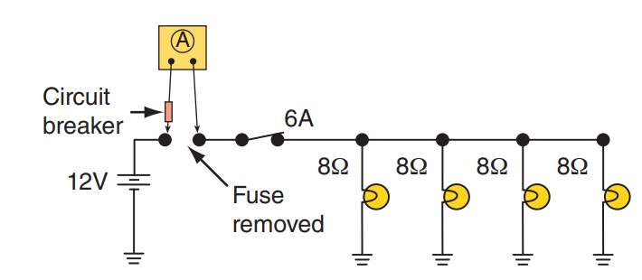
Measuring Current
Measuring the current through a circuit gives a true picture of what is happening in the circuit.
This is because the circuit is being tested under load.
Low current indicates that the circuit has high resistance, and high current means the circuit has low resistance.
Remember, to have current the circuit must be complete and there must be voltage applied to it.
The circuit shown normally draws 6 amps and is protected by a 10-amp fuse.
If the circuit constantly blows the fuse, something has reduced circuit resistance, and perhaps, there is a short somewhere in the circuit.

Slide 17
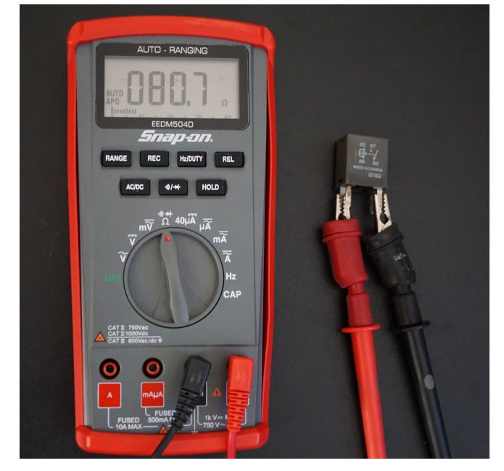
Measuring Resistance
To test circuit continuity and resistance, the circuit or component must first be disconnected from its power source.
Checking the resistance can check the condition of a component or circuit.
A DMM is used to check the resistance values across the switches when diagnosing certain concerns.
Often, specifications list a normal range of resistance values for specific parts.
If the resistance is too high, check for an open circuit or a faulty component.
Loose, damaged, or dirty connections are common causes of excessive resistance.
If the resistance is too low, check for a shorted circuit or faulty component.

Slide 18
Discussion
Now that we have covered how to use a DMM to test voltage, current, and resistance, have a class discussion.
Describe how to test voltage, current, and resistance from your own understanding.

Slide 19
MIN/MAX Readings
Some DMMs feature a MIN/MAX or Record function.
This displays the maximum, minimum, and average voltage recorded during a period of time.
This is valuable when checking sensors or when looking for electrical noise.
Electrical noise is primarily caused by radio frequency interference (RFI).
  RFI is an unwanted voltage signal that rides on another signal.
This noise can cause intermittent problems with unpredictable results.
This noise causes slight increases and decreases in the voltage.
When a computer receives a voltage signal with noise, it will try to react to those small changes.
As a result, the computer responds to the noise rather than the true voltage signal.

Slide 20
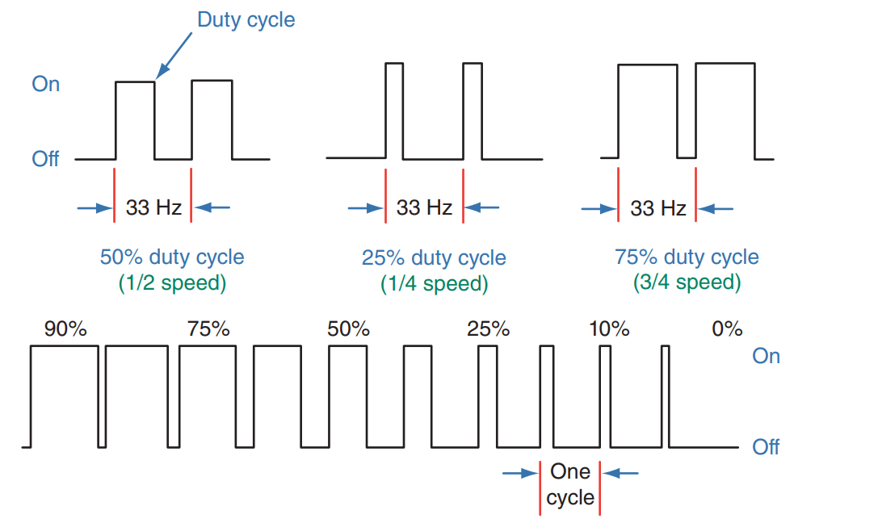
Other Measurements
Multimeters may have the ability to measure duty cycle, pulse width, and frequency.
Duty cycle is measured as a percentage.
A 60 percent duty cycle means that a device is on 60 percent of the time and off 40 percent of one cycle.
When measuring duty cycle, you are looking at the amount of time something is ON during one cycle.
An example of duty cycle in operation is when a dome light dims and then turns off after the door is closed.
The voltage to the light decreases in “on” time, eventually reaching zero.
Pulse width is normally measured in milliseconds.

Slide 21
Knowledge Check (1 of 2)
What is a lab scope?

Slide 22
Knowledge Check Answer (1 of 2)
Answer: Lab scopes are fast-reacting meters that measure and display voltages within a specific period of time.

Slide 23
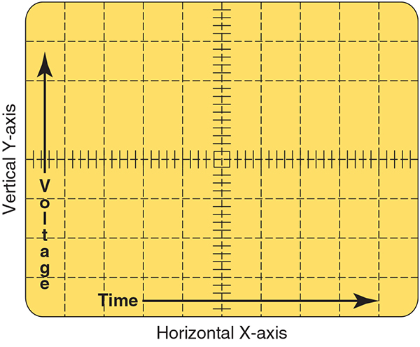
Using Lab Scopes (1 of 4)
16.05 Explain how to use a lab scope for diagnosing electrical and electronic systems.
The lab scope has become the diagnostic tool of choice.
DMMs sample the voltage several times each second and update the meter’s reading at a particular rate.
If the voltage is constant, good measurements are made.
A scope, however, will display any change in voltage as it occurs. This is important for diagnosing intermittent problems.
The screen is divided into small divisions of time and voltage.
These set up a grid pattern on the screen. Time is represented by the horizontal movement of the trace. Voltage by the vertical movement of the trace.

Slide 24
Using Lab Scopes (2 of 4)
Analog scopes show the actual activity of a circuit and are called real-time or live scopes. This means that what is taking place at that time is what you see on the screen.
Analog scopes have a fast update rate that allows for the display of activity without delay.
Analog scopes have been replaced by digital scopes
A digital scope, sometimes called a digital storage oscilloscope or DSO, converts the voltage signal into digital information and stores it in its memory.
Some scopes connect directly to a computer or may be part of a diagnostic tool. A technician can “freeze” the captured signal for close analysis.
DSOs also can capture both high- and low-frequency signals. Modern DSOs have a sampling rate of millions to a billion samples per second. This is quick enough to serve as an excellent diagnostic tool.
This fast sampling rate shows slight changes in the voltage. Slight and quick voltage changes cannot be observed on an analog scope.

Slide 25
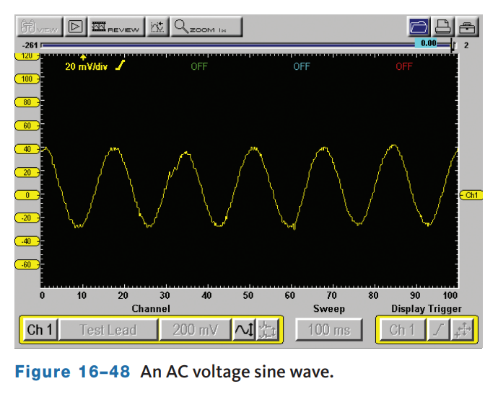
Using Lab Scopes (3 of 4)
Since the height of a waveform represents voltage, any change in the height of the trace indicates a change in the voltage. When the trace is a straight horizontal line, the voltage is constant.
A diagonal line up or down represents a gradual increase or decrease in voltage.
A sudden rise or fall in the trace indicates a sudden change in voltage. A normal AC signal changes its polarity and amplitude over time.
The waveform created by AC voltage is typically called a sine wave.
One complete sine wave is a cycle.
The number of cycles that occur per second is the frequency of the signal. Frequency is measured in cycles per second (hertz or Hz).

Slide 26
Using Lab Scopes (4 of 4)
Depending on the manufacturer and model of the scope, the variety of its controls will vary. however, nearly all scopes have vertical (Y-axis) adjustments, horizontal (X-axis) adjustments, and trigger adjustments.
The vertical adjustment controls the voltage that may be shown per division or as voltage over a preset figure, such as 20 volts.
If the scope is set at 0.5 (500 mV) volt, a 5-volt signal will need 10 divisions. Likewise, if the scope is set to 1 volt, 5 volts will need only five divisions.
It is important to set the vertical so that voltage can be accurately read. Setting the voltage too low may cause the waveform to move off the screen, whereas setting it too high may cause the trace to be flat and unreadable.
The horizontal position control is the time control of the trace.
If the time per division is set too low, the complete trace may not show across the screen.
Also, if the time per division is set too high, the trace may be too crowded for detailed observation.

Slide 27
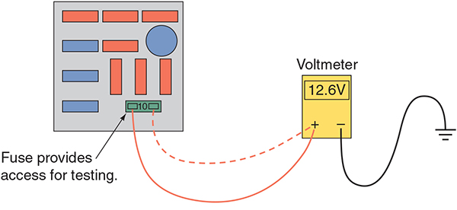
Testing Basic Electrical Components (1 of 4)
When overloads or shorts cause too much current, the wiring heats up, the insulation melts, and a fire can result unless the circuit has some kind of protective device.
Fuses, fuse links, maxifuses, and circuit breakers are designed to provide protection from high current.
They may be used singularly or in combination. Circuit protection devices can be checked with an ohmmeter or test light.
If they are good, there will be continuity through them. To test a circuit protection device with a voltmeter, check for available voltage at both terminals of the unit.
There should be voltage on both sides. Measuring voltage drop can tell more about a device’s condition than just its continuity.

Slide 28
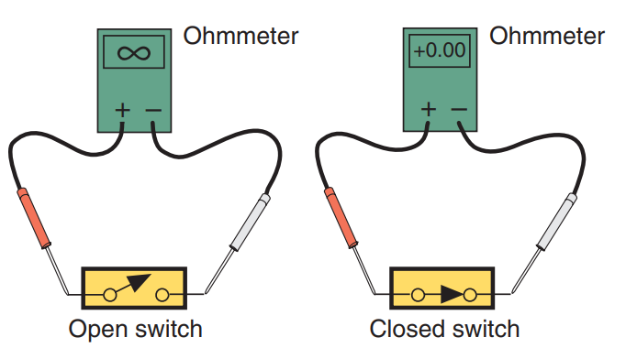
Testing Basic Electrical Components (2 of 4)
To check a switch, disconnect the connector at the switch.
Check for continuity between the terminals of the switch with the switch in the on and off positions.
While in the off position, there should be no continuity between the terminals.
With the switch on, there should be good continuity between the terminals.
If the switch is activated by something mechanical and does not complete the circuit when it should, check the adjustment of the switch (some switches are not adjustable).
Another way to check a switch is to bypass it with a jumper wire, if the component works when the switch is jumped, the switch is bad.

Slide 29
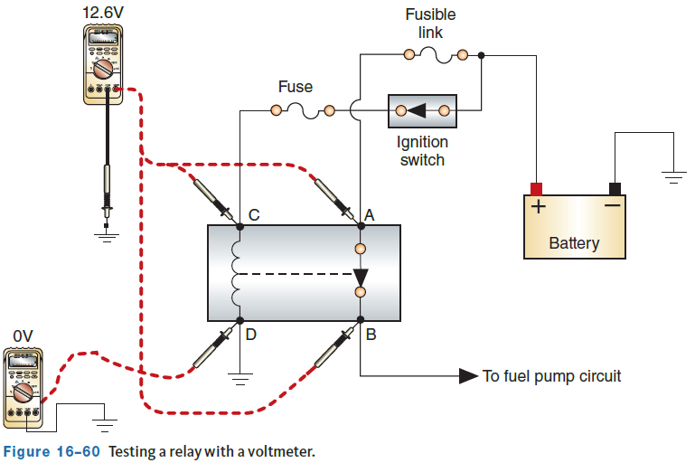
Testing Basic Electrical Components (3 of 4)
A relay can be checked with a jumper wire, a voltmeter, an ohmmeter, or a test light.
The schematic for a relay is typically shown on the outside of the relay.
Use an ohmmeter to check the continuity between the relay coil terminals.
If the meter indicates an infinite reading, replace the relay.
If there is continuity, use a pair of jumper wires or a 9-volt battery to energize the coil.
Check for continuity through the relay contacts.
If there is an infinite reading, the relay is faulty.
If there is continuity, the relay is good.

Slide 30
Testing Basic Electrical Components (4 of 4)
Stepped Resistors
  To test a stepped resistor, remove it and connect an ohmmeter across the resistor.
  Compare the readings to specifications.
  A stepped resistor can also be checked with a voltmeter.
  Measure the voltage after each part of the resistor block and compare the readings to specifications.

Slide 31
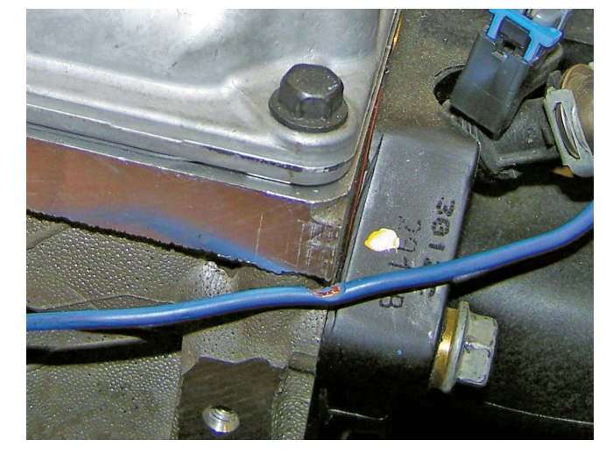
Wiring
A wire’s insulation should be in good condition. Broken, frayed, or damaged insulation can cause shorts.
A short circuit can cause wiring to overheat, which can melt insulation and connectors.
High resistance in a connection often leads to overheating and damage.
Whenever you see a wire or connector that shows signs of overheating, a thorough diagnosis of the fault is needed to identify the root cause of the failure.
These conditions can also create a safety hazard.
Replace all wires that have damaged insulation.
When checking a circuit, make sure to check the ground connections, including the ground strap from the engine or other component to the chassis.

Slide 32
Troubleshooting Circuits
The basic steps for diagnosis given earlier in this book should be followed.
Here they are again, only modified to fit electrical problems:
  If something does not work, the problem is most likely caused by a short or an open. But remember, shorts and opens do not always just happen. Often, there is another problem that causes the short or open to occur.
  If the fuse for that circuit is blown, the problem is a short. If the fuse is good, the problem is an open or high resistance.
  If a part does not work correctly, such as a dim light bulb, the problem is high resistance.
  Quick voltage checks will help define the problem. Check for voltage to the part that is not working correctly. If source voltage is present, the part is bad or the ground circuit is faulty. If less than source voltage is measured at the part, there is a fault in the power feed to the part. Check the voltage on the ground for the component. Source voltage on the ground side of a load indicates an open ground circuit. A voltage reading above 200 mV indicates resistance in the ground circuit.

Slide 33
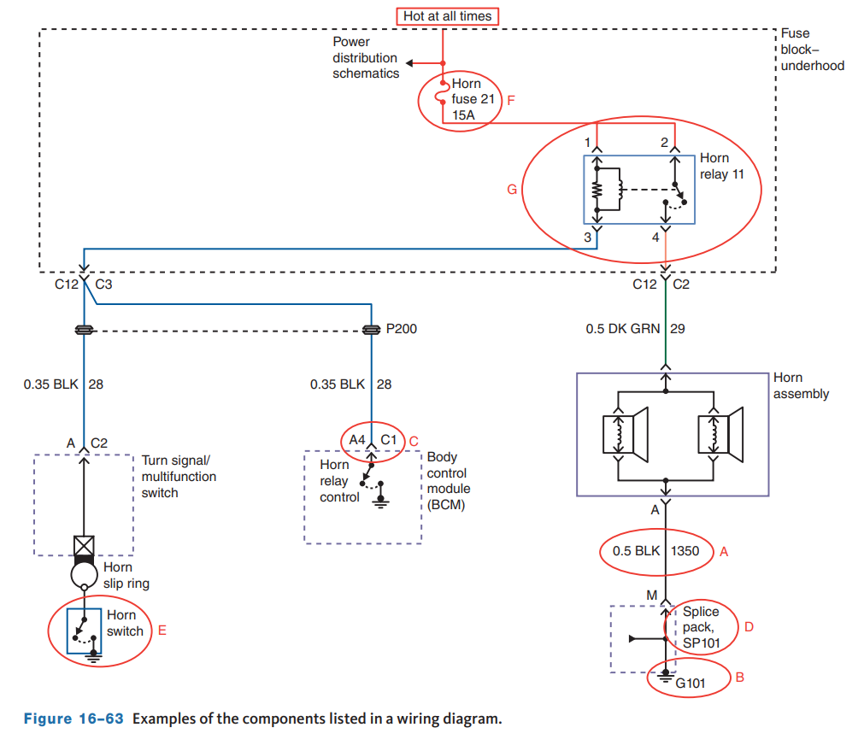
Using Wiring Diagrams
During diagnosis, one of the most important sources of information is a wiring diagram.
This shows the relationships of one circuit to the others.
Based on an understanding of the diagram, electricity, and how a particular system is designed to work, testing points can be identified.
Wiring diagrams are included in the electrical section of most service information. Wiring diagrams contain a comprehensive look at each circuit with all the connectors, wiring, signal connections between the devices, and electrical or electronic components of the circuit.
The diagrams are drawn with lines that represent wires between the appropriate connectors. Most diagrams are drawn so the power source is on the top of the wiring diagram and the ground source at the bottom.

Slide 34
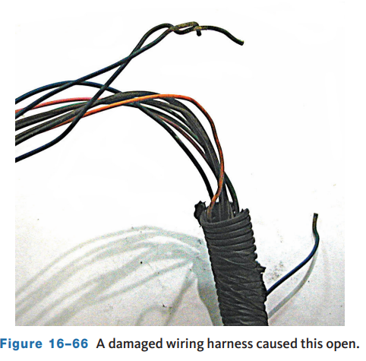
Testing For Common Problems (1 of 4)
16.07 Diagnose common electrical circuit problems.
An open is evident by an inoperative component or circuit.
Begin your testing at the most accessible place in the circuit and work from there.
Check for voltage at the positive side of the load.
If there are 0 volts, move to the output of the control.
If there are at least 10.5 volts, the open is between the control and the load. If the reading at the load is 10.5 volts or higher, check the ground side of the load. If the voltage on the ground side is 1 volt or lower and the load does not work, the load is bad.
If the voltage at ground is greater than 1 volt, there is excessive resistance or an open in the ground circuit. If source voltage is present on both the power and ground side of the load, the ground circuit is open.

Slide 35
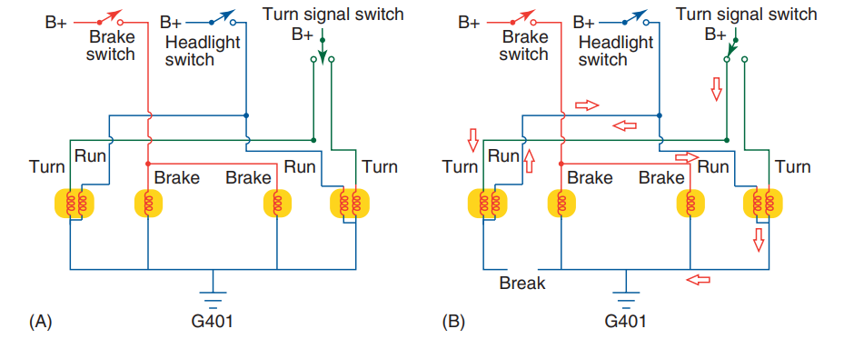
Testing For Common Problems (2 of 4)
Depending on the circuit, an open ground can present problems that you may not think of as an open circuit.
For example, in a rear lighting circuit like shown, several bulbs are all connected together with a common ground.
If an open occurs in the ground for the turn signal/running light, in this example circuit, when the left turn signal is turned on, the current can pass from turn signal filament to the running light filament.
The current then continues on to the other turn signal/running light bulb to get to ground, which may cause both running lights to blink with the turn signal or may cause all three lights to glow.

Slide 36
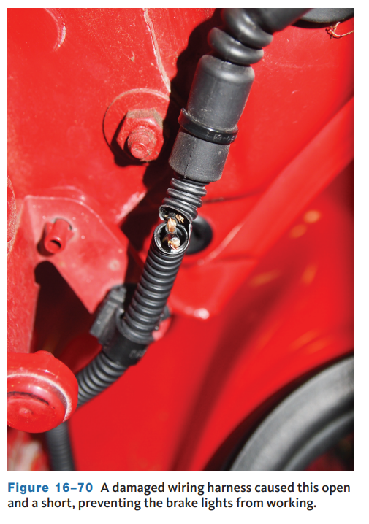
Testing For Common Problems (3 of 4)
Use an ohmmeter to check for an internal short in a component, such as a relay or fuel injector.
If the component is good, the meter will read the specified resistance or at least some resistance.
If it is shorted, it will read lower than normal or near zero resistance.
Also, if the component has more than two terminals or pins, check for continuity across all combinations of these. Refer to the wiring diagram to see where there should be continuity.
Any abnormal readings indicate an internal short.
When a fuse is blown, this probably is due to a wire-to-wire short or a short to ground.
To test these circuits, a special jumper wire with a circuit breaker should be used as a substitute for the blown fuse. This will allow for testing the circuit without causing damage to the wires and components in the circuit.

Slide 37
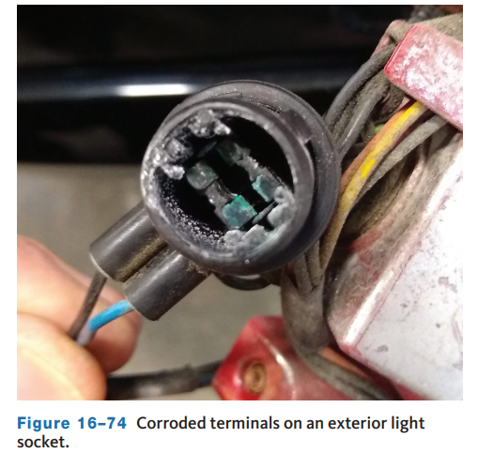
Testing For Common Problems (4 of 4)
High-resistance problems are typically caused by corrosion on terminal ends, loose or poor connections, or frayed and damaged wires.
Whenever excessive resistance is suspected, both sides of the circuit should be checked.
Begin by checking the voltage drop across the load.
This should be close to battery voltage unless the circuit contains a resistor located before the load.
If the voltage drop is excessive, that part of the circuit contains the unwanted resistance.
The higher the voltage drop, the higher the resistance is, and only the load in the circuit should have high resistance.
It is also possible to measure the resistance with the meter on the resistance setting, although voltage drop is preferred.

Slide 38
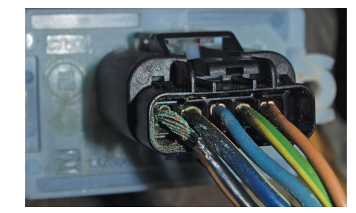
Connector and Wire Repairs (1 of 4)
16.08 Perform wire and connector repairs.
When installing a terminal, select the appropriate size and type of terminal. Be sure it fits the unit’s connecting post or prongs and it has enough current-carrying capacity for the circuit.
Check all connectors for corrosion, dirt, and looseness.
Nearly all connectors have pushdown release-type locks. Make sure these are not damaged.
Many connectors have covers over them to protect them from dirt and moisture. Make sure these are properly installed to provide for that protection.
When a connector needs to be replaced because the original has melted or is otherwise damaged, attempt to replace it with the same type and size.

Slide 39
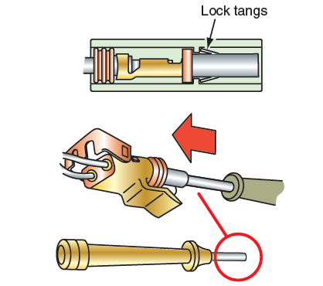
Connector and Wire Repairs (2 of 4)
Replacing a Terminal
  Terminal ends are replaced when they are damaged or to accommodate the use of a connector.
  The replacement process must be done to provide for good continuity and to prevent electrical problems in the future.
  Never reroute wires when making repairs.
  Rerouting wires can result in induced voltages in nearby components.
    Induced voltages produce unwanted signals through magnetism rather than from the components within the circuit.
    These stray voltages can interfere with the function of electronic circuits.

Slide 40
Connector and Wire Repairs (3 of 4)
Often, electrical problems require the replacement of a wire or two.
It is important that this is done in a way that corrects the original problem but does not create a new problem.
All replacement wires should be of the same size or larger than the original.
If adding an accessory, the new wire should be large enough to ensure safe and reliable performance. However, overly large wires add weight and expense, and add to the difficulty of splicing wires together.
If the wire is too small, an unwanted voltage drop can occur.
The two factors that should always be considered when determining the correct size of a wire are the total circuit amperage and the total length of wire (resistance increases with length) used in each circuit, including the ground.

Slide 41
Connector and Wire Repairs (4 of 4)
When a section of a wire needs to be replaced, cut the damaged end of the wire from the main wire.
Match the dimensions of the new wire to the old one.
Measure the required length of the replacement wire; make sure it is slightly longer than the section that was removed. Then connect the two wires together.
There are several ways of connecting the original wire to a replacement wire.
Butt connectors can provide a good joint between the wires. However, the preferred way to connect wires or to install a connector is by soldering.
Soldering joins two pieces of metal together by melting a lead and tin alloy and allowing it to flow into the joint. A soldering iron or gun is used to heat the solder.
Tightly wrap the tape around the wire. As the tape is being wrapped, about one half of the previous wrap should be covered by the tape as it completes one turn around the wire.
When using heat shrink tubing, make sure the tubing is slightly larger than the diameter of the splice. Use a heat gun and heat the tubing until it shrinks tightly around the splice.

Slide 42
Knowledge Check (2 of 2)
Describe two ways of connecting the original wire to a replacement wire, and two ways to make the connection water tight and insulated.

Slide 43
Knowledge Check Answer (2 of 2)
To make the connection: Butt connector, soldering.
To seal the connection: Tape, heat shrink tubing.

Slide 44
Chapter Reflection
Please take a moment to consider what you have learned. Then respond to the following questions in one or two paragraphs. Use 150–200 words in your reflection.
Did you learn anything new about electrical system diagnosis? What about electrical system service? How can you reinforce your newly learned information?
Considering all you have learned, do you feel you are able to apply what you have learned to performing electrical system diagnosis and service? Is there anything you should study more to be better prepared?

